Slide 1
W4111 – Introduction to Databases Section 002, Spring 2021 Lecture 5: Advanced SQL and Projects
© Donald F. Ferguson, 2021

Slide 2
W4111 – Introduction to Databases Section 002, Spring 2021 Lecture 5: Advanced SQL and Projects
We will start in a couple of minutes.
© Donald F. Ferguson, 2021

Slide 3

Contents
3 | COMS W4111_002_2021_1: Lecture 5: Advanced SQL and Projects © Donald F. Ferguson, 2021

Slide 4
Contents
Final SQL Concepts:
Constraints.
Indexes.
Metadata and Catalog (and an insight into HW2, programming).
More Set Like Concepts (Slides at end of presentation. Please just read).
Functions, Triggers, Procedures.
Some Advanced ER → Relational Mapping
Multi-valued attributes.
Inheritance.
N-ary relationships, for N > 2.
Starting to Understand HW3 and HW4 – The Projects:
Overview and concepts.
My project as an example.

Slide 5
Constraints
5 | COMS W4111_002_2021_1: Lecture 5: Advanced SQL and Projects © Donald F. Ferguson, 2021

Slide 6
Integrity Constraints
Integrity constraints guard against accidental damage to the database, by ensuring that authorized changes to the database do not result in a loss of data consistency.
A checking account must have a balance greater than $10,000.00
A salary of a bank employee must be at least $4.00 an hour
A customer must have a (non-null) phone number
Application A
Application B
... ...
... ...
Application N
Note:
Integrating constraints as part of data definition is one of the major benefits.
Eliminates the need to coordinate code in multiple applications.
Move integrity rules
From multiple programs.
To data.

Slide 7
Constraints on a Single Relation
not null
primary key
unique
check (P), where P is a predicate

Slide 8
Not Null Constraints
not null
Declare name and budget to be not null
name varchar(20) not null budget numeric(12,2) not null

Slide 9
Unique Constraints
unique ( A₁, A₂, …, A_{m})
The unique specification states that the attributes A₁, A₂, …, A_{m} form a candidate key.
Candidate keys are permitted to be null (in contrast to primary keys).

Slide 10
The check clause
The check (P) clause specifies a predicate P that must be satisfied by every tuple in a relation.
Example: ensure that semester is one of fall, winter, spring or summer
create table section
(course_id varchar (8),
sec_id varchar (8),
semester varchar (6),
year numeric (4,0),
building varchar (15),
room_number varchar (7),
time slot id varchar (4),
primary key (course_id, sec_id, semester, year),
check (semester in ('Fall', 'Winter', 'Spring', 'Summer')))
Notes:
I would make semester an ENUM.
I normally keep check constraints relatively simple predicates on attributes.
Not all engines support the more sophisticated features, e.g. subqueries.

Slide 11
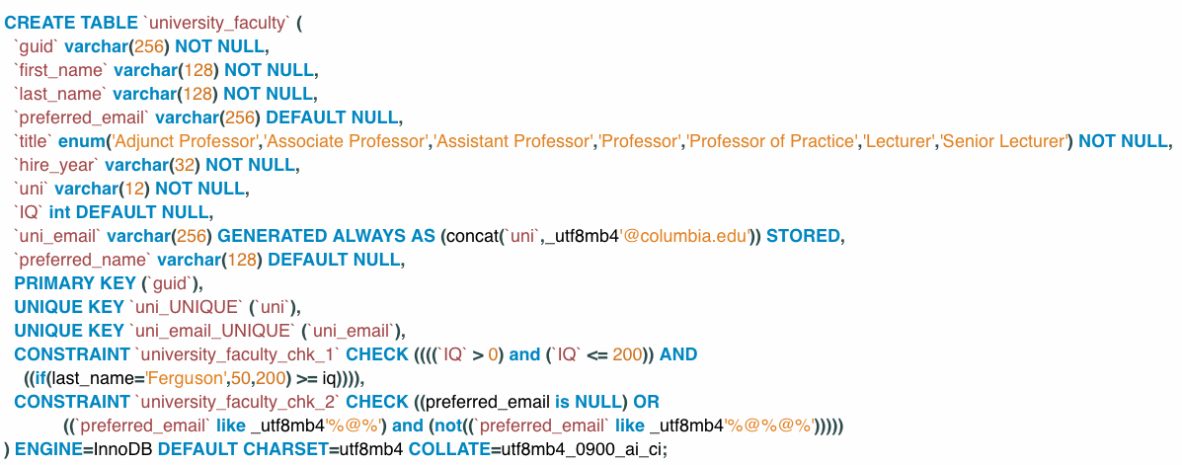
Check Constraint and other Things
Switch to notebook for example.
Two simple check constraints.
Two unique keys: uni cannot be NULL, preferred_email must be unique if not NULL.
Auto-generated column: uni_email
Example of an ENUM.

Slide 12
Referential Integrity
Ensures that a value that appears in one relation for a given set of attributes also appears for a certain set of attributes in another relation.
Example: If “Biology” is a department name appearing in one of the tuples in the instructor relation, then there exists a tuple in the department relation for “Biology”.
Let A be a set of attributes. Let R and S be two relations that contain attributes A and where A is the primary key of S. A is said to be a foreign key of R if for any values of A appearing in R these values also appear in S.

Slide 13
Referential Integrity (Cont.)
Foreign keys can be specified as part of the SQL create table statement
foreign key (dept_name) references department
By default, a foreign key references the primary-key attributes of the referenced table.
SQL allows a list of attributes of the referenced relation to be specified explicitly.
foreign key (dept_name) references department (dept_name)

Slide 14
Cascading Actions in Referential Integrity
When a referential-integrity constraint is violated, the normal procedure is to reject the action that caused the violation.
An alternative, in case of delete or update is to cascade
create table course ( (… dept_name varchar(20), foreign key (dept_name) references department on delete cascade on update cascade, . . .)
Instead of cascade we can use :
set null,
set default
Note:
I do not use cascading, but that is just my preference.
I believe that changes should be explicit, not implemented behind the scenes.

Slide 15
Integrity Constraint Violation During Transactions
Consider:
create table person ( ID char(10), name char(40), mother char(10), father char(10), primary key ID, foreign key father references person, foreign key mother references person)
How to insert a tuple without causing constraint violation?
Insert father and mother of a person before inserting person
OR, set father and mother to null initially, update after inserting all persons (not possible if father and mother attributes declared to be not null)
OR defer constraint checking
Note: Do not worry about transaction for now.

Slide 16
Complex Check Conditions
The predicate in the check clause can be an arbitrary predicate that can include a subquery.
check (time_slot_id in (select time_slot_id from time_slot))
The check condition states that the time_slot_id in each tuple in the section relation is actually the identifier of a time slot in the time_slot relation.
The condition has to be checked not only when a tuple is inserted or modified in section , but also when the relation time_slot changes
Note:
Not all databases support complex check conditions.
You can use triggers, which we will cover, to implement more complex check constraints.

Slide 17
Assertions
An assertion is a predicate expressing a condition that we wish the database always to satisfy.
The following constraints, can be expressed using assertions:
For each tuple in the student relation, the value of the attribute tot_cred must equal the sum of credits of courses that the student has completed successfully.
An instructor cannot teach in two different classrooms in a semester in the same time slot
An assertion in SQL takes the form:
create assertion <assertion-name> check (<predicate>);
Note: Assertions are inconsistently supported and not that common.

Slide 18
User-Defined Types
create type construct in SQL creates user-defined type
create type Dollars as numeric (12,2) final
Example:
create table department (dept_name varchar (20), building varchar (15), budget Dollars);
Note:
Domains and UDTs are an important concept but not as well supported as they should be.

Slide 19
Domains
create domain construct in SQL-92 creates user-defined domain types
create domain person_name char(20) not null
Types and domains are similar. Domains can have constraints, such as not null, specified on them.
Example:
create domain degree_level varchar(10) constraint degree_level_test check (value in ('Bachelors', 'Masters', 'Doctorate'));
Note:
Support for domains is also inconsistent.

Slide 20
Defining Indexes
20 | COMS W4111_002_2021_1: Lecture 4: ER, Relational, SQL (IV) © Donald F. Ferguson, 2021

Slide 21
Index Creation
Many queries reference only a small proportion of the records in a table.
It is inefficient for the system to read every record to find a record with particular value
An index on an attribute of a relation is a data structure that allows the database system to find those tuples in the relation that have a specified value for that attribute efficiently, without scanning through all the tuples of the relation.
We create an index with the create index command
create index <name> on <relation-name> (attribute);
Note:
MySQL conflates and makes obscure concepts like Key, Constraint and Index.
MySQL Indexes:
Primary
Unique
Index
Full Index
These are actually constraints. Indexes are necessary efficiently enforcing constraints.

Slide 22
Index Creation Example
create table student (ID varchar (5), name varchar (20) not null, dept_name varchar (20), tot_cred numeric (3,0) default 0, primary key (ID))
create index studentID_index on student(ID)
The query:
select * from student where ID = '12345'
can be executed by using the index to find the required record, without looking at all records of student

Slide 23
Complex Example Columbia Courses, Sections, Enrollments (Part I – Course)
23 | COMS W4111_002_2021_1: Lecture 5: Advanced SQL and Projects © Donald F. Ferguson, 2021

Slide 24
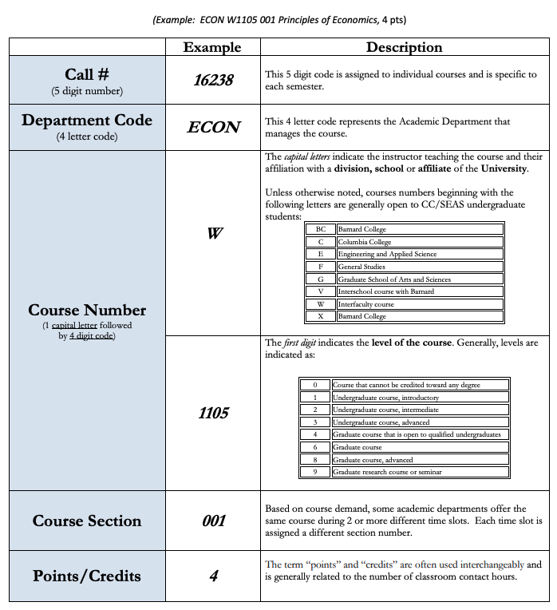
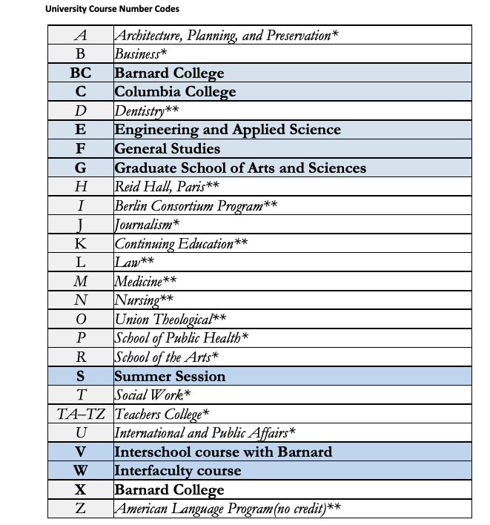
Columbia Courses

Slide 25
Columbia Courses
I am going to ignore the more complex table of instructor affiliation codes, and use the simple set.

Slide 26
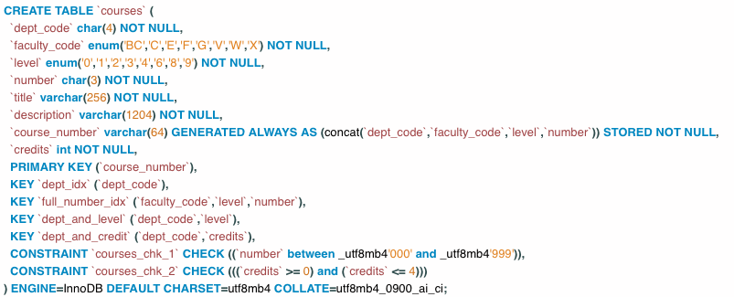
Course Number
Switch to notebook.
Some observations:
faculty_code and level are ENUMs, which you declare as strings.
There is a check constraint that ensures that the last 3 digits of the number are between ‘000’ and ‘999’, and a constraint on credits.
We always generate the full course_number. We store the value (versus compute on demand) → it can be a key.
Will talk about indexes in a minute.

Slide 27
MySQL Indexes
The MySQL Index Types are: Primary, Index, Unique, Full Text.
Comment 1: This conflates indexes for efficiency and constraints for integrity, e.g. Primary, Unique.
What is this Full Text index of which you speak?
ALTER TABLE `aaaa_simple_university`.`courses` ADD FULLTEXT INDEX `key_words` (`title`, `description`) VISIBLE;
Enables querying for courses that contain a specific word or words.
Note:
This is NOT how large-scale text search works.
The search is on whole words, not partial words → Does not support autocomplete.
You can define “stop words” that the query/index ignores, e.g. “the”, “it”, ... https://dev.mysql.com/doc/refman/8.0/en/fulltext-stopwords.html
Go to notebook

Slide 28
Metadata and Catalog
28 | COMS W4111_002_2021_1: Lecture 4: ER, Relational, SQL (IV) © Donald F. Ferguson, 2021

Slide 29
Metadata and Catalog
‘Metadata is "data that provides information about other data". In other words, it is "data about data". Many distinct types of metadata exist, including descriptive metadata, structural metadata, administrative metadata, reference metadata and statistical metadata.’ (https://en.wikipedia.org/wiki/Metadata)
“The database catalog of a database instance consists of metadata in which definitions of database objects such as base tables, views (virtual tables), synonyms, value ranges, indexes, users, and user groups are stored. ... ... The SQL standard specifies a uniform means to access the catalog, called the INFORMATION_SCHEMA, but not all databases follow this ...” (https://en.wikipedia.org/wiki/Database_catalog)
Codd’s Rule 4: Dynamic online catalog based on the relational model:
The data base description is represented at the logical level in the same way as ordinary data, so that authorized users can apply the same relational language to its interrogation as they apply to the regular data.

Slide 30
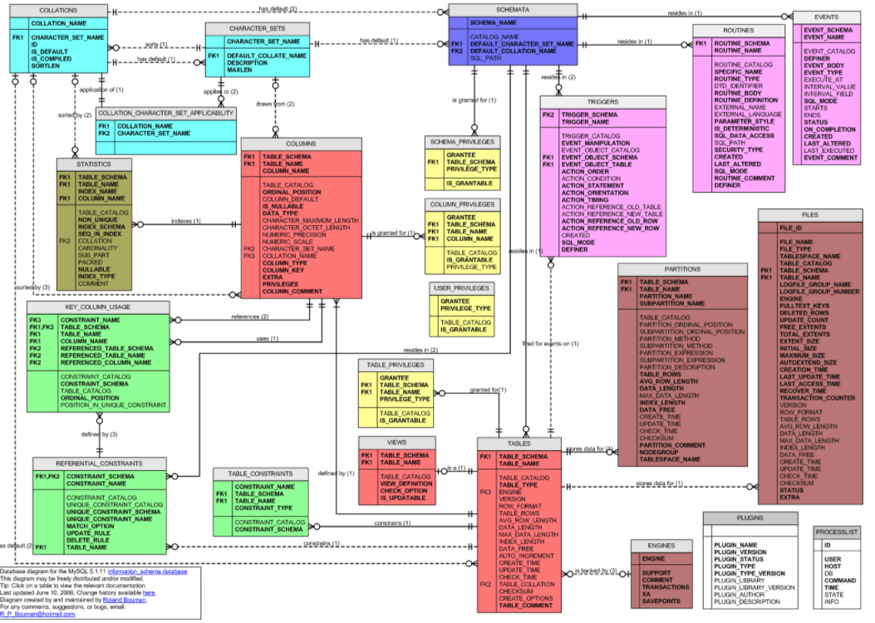
MySQL Catalog (Information_Schema)
Some of the MySQL Information Schema Tables:
'ADMINISTRABLE_ROLE_AUTHORIZATIONS'
'APPLICABLE_ROLES'
'CHARACTER_SETS'
'CHECK_CONSTRAINTS'
'COLUMN_PRIVILEGES'
'COLUMN_STATISTICS'
'COLUMNS'
'ENABLED_ROLES'
'ENGINES'
'EVENTS'
'FILES'
'KEY_COLUMN_USAGE'
'PARAMETERS'
'REFERENTIAL_CONSTRAINTS'
'RESOURCE_GROUPS'
'ROLE_COLUMN_GRANTS'
'ROLE_ROUTINE_GRANTS'
'ROLE_TABLE_GRANTS'
'ROUTINES'
'SCHEMA_PRIVILEGES'
'STATISTICS'
'TABLE_CONSTRAINTS'
'TABLE_PRIVILEGES'
'TABLES'
'TABLESPACES'
'TRIGGERS'
'USER_PRIVILEGES'
'VIEW_ROUTINE_USAGE'
'VIEW_TABLE_USAGE'
'VIEWS'
CREATE and ALTER statements modify the data.
DBMS reads information:
Parsing
Optimizer
etc.

Slide 31
Basic Steps in Query Processing
Database Catalog
Tables, columns, types, ... needed to check syntax.
Statistics used for cost based optimization and plans.
1. Parsing and translation
2. Optimization
3. Evaluation
Switch to notebook.

Slide 32
DDL and DML (and HW2)
CSVCatalog provides APIs for defining metadata.
CSVTable uses the metadata to correctly and efficiently support find_by_template, join, insert, ...
CSVTable (DML Engine)
CSVCatalog (DDL Engine)
File System
MySQL
Databases
App DB
App DB
App DB
App DB
App DB
HW2 DB Simple Catalog
Catalog
App DB
People.csv
App DB
Catalog

Slide 33
DDL and DML (and HW2)
CSVCatalog provides APIs for defining metadata.
CSVTable uses the metadata to correctly and efficiently support find_by_template, join, insert, ...
Switch to notebook.
CSVTable (DML Engine)
CSVCatalog (DDL Engine)
File System
MySQL
Databases
App DB
App DB
App DB
App DB
App DB
HW2 DB Simple Catalog
Catalog
App DB
People.csv
App DB
Catalog

Slide 34
Functions, Procedures, Triggers
34 | COMS W4111_002_2021_1: Lecture 4: ER, Relational, SQL (IV) © Donald F. Ferguson, 2021

Slide 35

Concepts
35 | COMS W4111_002_2021_1: Lecture 5: Advanced SQL and Projects © Donald F. Ferguson, 2021

Slide 36
Functions and Procedures
Functions and procedures allow “business logic” to be stored in the database and executed from SQL statements.
These can be defined either by the procedural component of SQL or by an external programming language such as Java, C, or C++.
The syntax we present here is defined by the SQL standard.
Most databases implement nonstandard versions of this syntax.
Note:
The programming language, runtime and tools for functions, procedures and triggers are not easy to use.
My view is that calling external functions is an anti-pattern (bad idea).
External code degrades the reliability, security and performance of the database.
Databases are often mission critical and the heart of environments.

Slide 37
Language Constructs for Procedures & Functions
SQL supports constructs that gives it almost all the power of a general-purpose programming language.
Warning: most database systems implement their own variant of the standard syntax below.
Compound statement: begin … end,
May contain multiple SQL statements between begin and end.
Local variables can be declared within a compound statements
While and repeat statements:
while boolean expression do
sequence of statements ;
end while
repeat
sequence of statements ;
until boolean expression
end repeat

Slide 38
(Core) Language Constructs (Cont.)
For loop
Permits iteration over all results of a query
Example: Find the budget of all departments declare n integer default 0; for r as select budget from department where dept_name = 'Music' do set n = n + r.budget end for
Note:
There are various other looping constructs.

Slide 39
(Core) Language Constructs – if-then-else
Conditional statements (if-then-else)
if boolean expression then statement or compound statement elseif boolean expression then statement or compound statement else statement or compound statement end if
Note:
We will not spend a lot of time writing functions, procedures, or triggers.
The language and development environment are not easy to use.

Slide 40
Functions
40 | COMS W4111_002_2021_1: Lecture 5: Advanced SQL and Projects © Donald F. Ferguson, 2021

Slide 41
Declaring SQL Functions
Define a function that, given the name of a department, returns the count of the number of instructors in that department.
create function dept_count (dept_name varchar(20)) returns integer begin declare d_count integer; select count (* ) into d_count from instructor where instructor.dept_name = dept_name return d_count; end
The function dept_count can be used to find the department names and budget of all departments with more that 12 instructors.
select dept_name, budget from department where dept_count (dept_name ) > 12

Slide 42
Table Functions
The SQL standard supports functions that can return tables as results; such functions are called table functions
Example: Return all instructors in a given department
create function instructor_of (dept_name char(20))
returns table (
ID varchar(5), name varchar(20), dept_name varchar(20), salary numeric(8,2))
return table (select ID, name, dept_name, salary from instructor where instructor.dept_name = instructor_of.dept_name)
Usage
select * from table (instructor_of ('Music'))

Slide 43
Switch to Notebook
Switch to Notebook

Slide 44
Procedures
44 | COMS W4111_002_2021_1: Lecture 5: Advanced SQL and Projects © Donald F. Ferguson, 2021

Slide 45
SQL Procedures
The dept_count function could instead be written as procedure:
create procedure dept_count_proc (in dept_name varchar(20), out d_count integer) begin
select count(*) into d_count from instructor where instructor.dept_name = dept_count_proc.dept_name
end
The keywords in and out are parameters that are expected to have values assigned to them and parameters whose values are set in the procedure in order to return results.
Procedures can be invoked either from an SQL procedure or from embedded SQL, using the call statement.
declare d_count integer; call dept_count_proc( 'Physics', d_count);

Slide 46
SQL Procedures (Cont.)
Procedures and functions can be invoked also from dynamic SQL
SQL allows more than one procedure of the so long as the number of arguments of the procedures with the same name is different.
The name, along with the number of arguments, is used to identify the procedure.

Slide 47
Procedures
47 | COMS W4111_002_2021_1: Lecture 5: Advanced SQL and Projects © Donald F. Ferguson, 2021

Slide 48
Triggers
A trigger is a statement that is executed automatically by the system as a side effect of a modification to the database.
To design a trigger mechanism, we must:
Specify the conditions under which the trigger is to be executed.
Specify the actions to be taken when the trigger executes.
Triggers introduced to SQL standard in SQL:1999, but supported even earlier using non-standard syntax by most databases.
Syntax illustrated here may not work exactly on your database system; check the system manuals

Slide 49
Triggering Events and Actions in SQL
Triggering event can be insert, delete or update
Triggers on update can be restricted to specific attributes
For example, after update of takes on grade
Values of attributes before and after an update can be referenced
referencing old row as : for deletes and updates
referencing new row as : for inserts and updates
Triggers can be activated before an event, which can serve as extra constraints. For example, convert blank grades to null.
create trigger setnull_trigger before update of takes referencing new row as nrow for each row when (nrow.grade = ' ') begin atomic set nrow.grade = null; end;

Slide 50
Trigger to Maintain credits_earned value
create trigger credits_earned after update of takes on (grade) referencing new row as nrow referencing old row as orow for each row when nrow.grade <> 'F' and nrow.grade is not null and (orow.grade = 'F' or orow.grade is null) begin atomic update student set tot_cred= tot_cred + (select credits from course where course.course_id= nrow.course_id) where student.id = nrow.id; end;

Slide 51
Statement Level Triggers
Instead of executing a separate action for each affected row, a single action can be executed for all rows affected by a transaction
Use for each statement instead of for each row
Use referencing old table or referencing new table to refer to temporary tables (called transition tables) containing the affected rows
Can be more efficient when dealing with SQL statements that update a large number of rows

Slide 52
When Not To Use Triggers
Triggers were used earlier for tasks such as
Maintaining summary data (e.g., total salary of each department)
Replicating databases by recording changes to special relations (called change or delta relations) and having a separate process that applies the changes over to a replica
There are better ways of doing these now:
Databases today provide built in materialized view facilities to maintain summary data
Databases provide built-in support for replication
Encapsulation facilities can be used instead of triggers in many cases
Define methods to update fields
Carry out actions as part of the update methods instead of through a trigger

Slide 53
When Not To Use Triggers (Cont.)
Risk of unintended execution of triggers, for example, when
Loading data from a backup copy
Replicating updates at a remote site
Trigger execution can be disabled before such actions.
Other risks with triggers:
Error leading to failure of critical transactions that set off the trigger
Cascading execution

Slide 54
Summary
54 | COMS W4111_002_2021_1: Lecture 5: Advanced SQL and Projects © Donald F. Ferguson, 2021

Slide 55
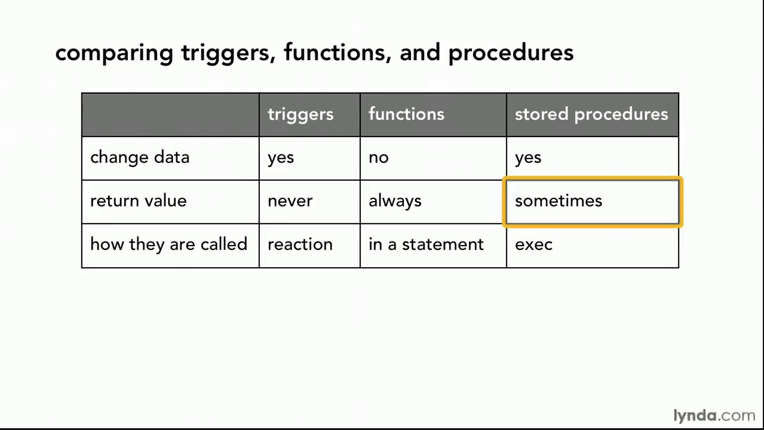
Comparison

Slide 56
Comparison – Some Details
A trigger has capabilities like a procedure, except ...
You do not call it. The DB engine calls it before or after an INSERT, UPDATE, DELETE.
The inputs are the list of incoming new, modified rows.
The outputs are the modified versions of the new or modified rows.

Slide 57
Complex Example Columbia Courses, Sections, Enrollments (Part I – Students and Faculty)
57 | COMS W4111_002_2021_1: Lecture 5: Advanced SQL and Projects © Donald F. Ferguson, 2021

Slide 58
IsA, Inheritance, Generalization, Specialization
58 | COMS W4111_002_2021_1: Lecture 5: Advanced SQL and Projects © Donald F. Ferguson, 2021

Slide 59
Faculty and Students
ER Notation
We modelled course.
To enroll students in courses, we need ...
Sections
Faculty
Students
Let’s focus on the “people aspect.” We have
People
A Faculty is a People.
A Student is a People.
“In object-oriented programming, inheritance is the mechanism of basing an object or class upon another object (prototype-based inheritance) or class (class-based inheritance), retaining similar implementation. Also defined as deriving new classes (sub classes) from existing ones such as super class or base class and then forming them into a hierarchy of classes.”
This is a new type of relationship in ER modeling.

Slide 60
Specialization
Top-down design process; we designate sub-groupings within an entity set that are distinctive from other entities in the set.
These sub-groupings become lower-level entity sets that have attributes or participate in relationships that do not apply to the higher-level entity set.
Depicted by a triangle component labeled ISA (e.g., instructor “is a” person).
Attribute inheritance – a lower-level entity set inherits all the attributes and relationship participation of the higher-level entity set to which it is linked.

Slide 61
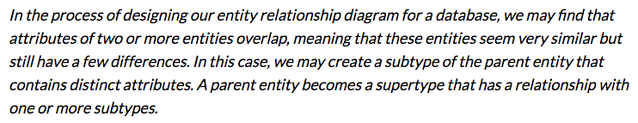
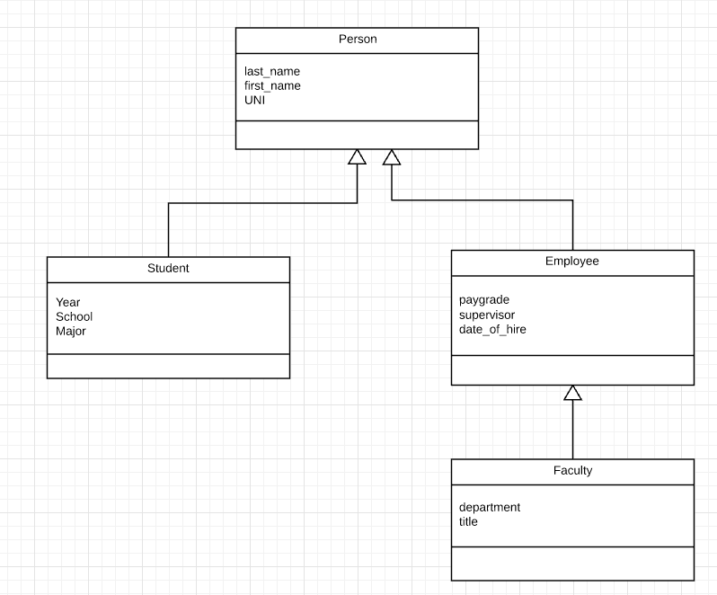
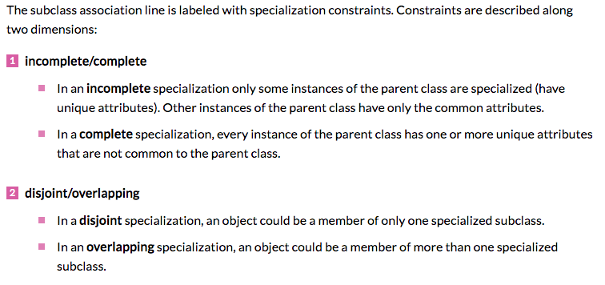
Inheritance, IsA, Specialization
Are all employees faculty?
Can students also be employees?
http://www.vertabelo.com/blog/technical-articles/inheritance-in-a-relational-database
61 | W4111_02_F20: Introduction to Databases – Lecture 6

Slide 62
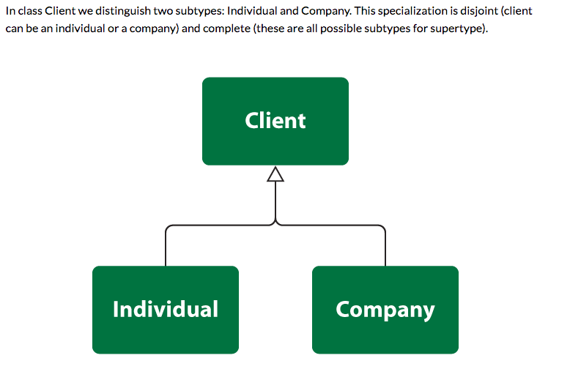
Simpler Example
62 | W4111_02_F20: Introduction to Databases – Lecture 6

Slide 63
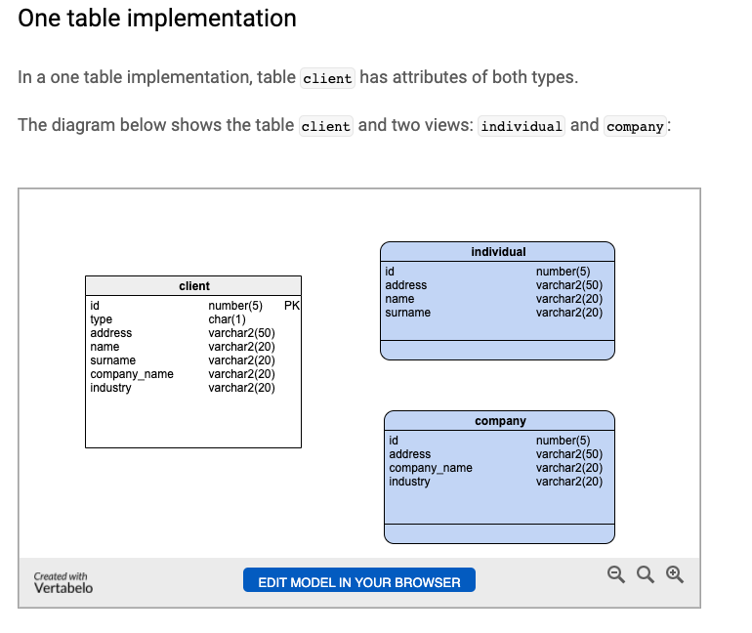
One Table Implementation
Views
Tables
63 | W4111_02_F20: Introduction to Databases – Lecture 6

Slide 64
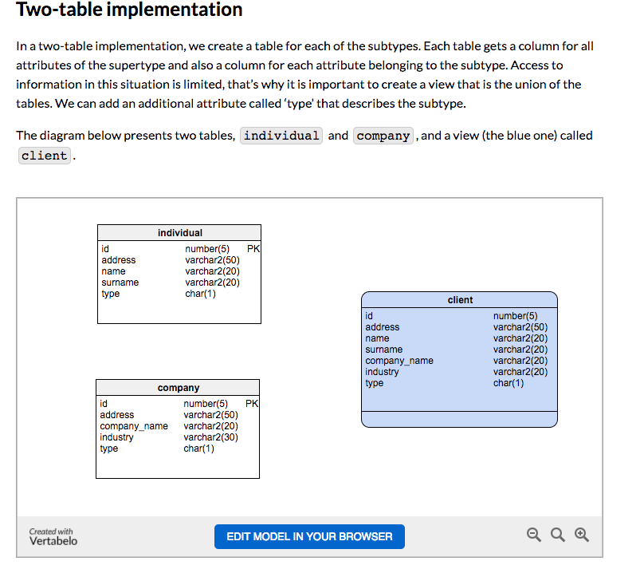
Two Table Implementation
View
Tables
64 | W4111_02_F20: Introduction to Databases – Lecture 6

Slide 65
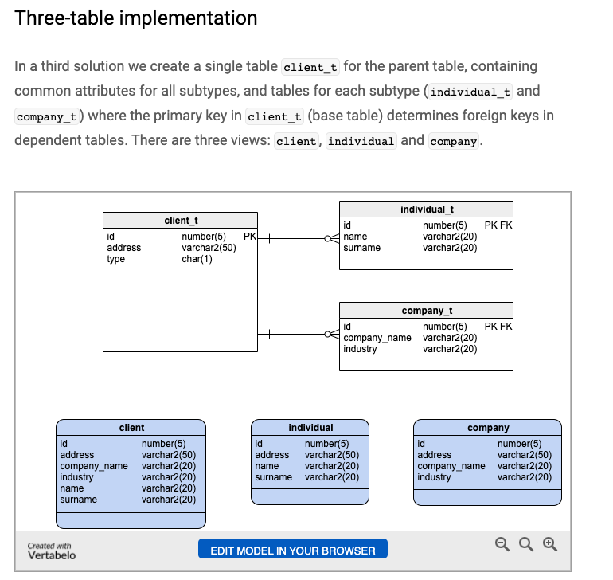
Two Table Implementation
Tables
Views
65 | W4111_02_F20: Introduction to Databases – Lecture 6

Slide 66
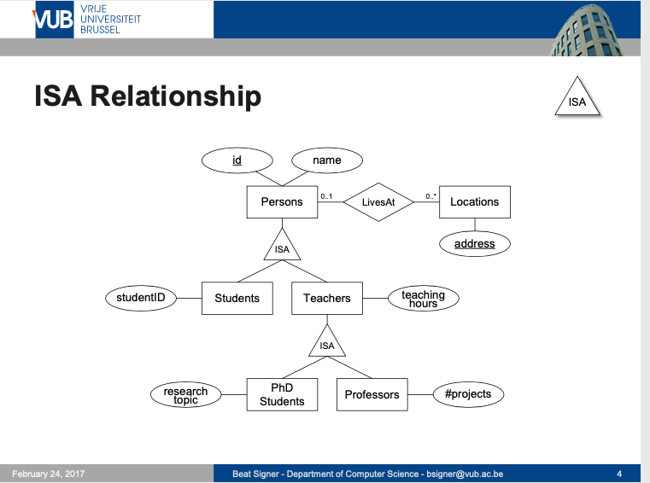
Modeling
66 | W4111_02_F20: Introduction to Databases – Lecture 6

Slide 67
ER vs. UML Class Diagrams
ER Diagram Notation
Equivalent in UML
I use this approach in Crow’s Foot Notation but that is not standard.
* Generalization can use merged or separate arrows independent
of disjoint/overlapping

Slide 68
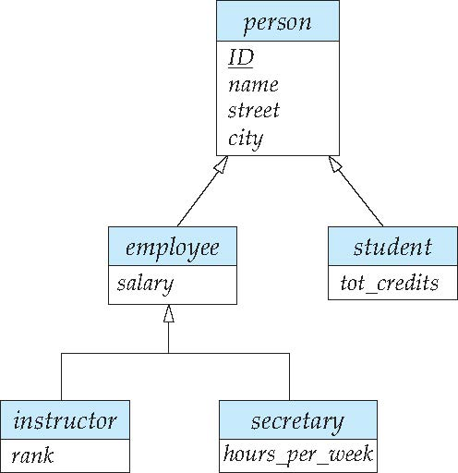
Specialization Example
Overlapping – employee and student
Disjoint – instructor and secretary
Total and partial

Slide 69
Generalization
A bottom-up design process – combine a number of entity sets that share the same features into a higher-level entity set.
Specialization and generalization are simple inversions of each other; they are represented in an E-R diagram in the same way.
The terms specialization and generalization are used interchangeably.

Slide 70
Completeness constraint
Completeness constraint -- specifies whether or not an entity in the higher-level entity set must belong to at least one of the lower-level entity sets within a generalization.
total: an entity must belong to one of the lower-level entity sets
partial: an entity need not belong to one of the lower-level entity sets

Slide 71
Completeness constraint (Cont.)
Partial generalization is the default.
We can specify total generalization in an ER diagram by adding the keyword total in the diagram and drawing a dashed line from the keyword to the corresponding hollow arrow-head to which it applies (for a total generalization), or to the set of hollow arrow-heads to which it applies (for an overlapping generalization).
The student generalization is total: All student entities must be either graduate or undergraduate. Because the higher-level entity set arrived at through generalization is generally composed of only those entities in the lower-level entity sets, the completeness constraint for a generalized higher-level entity set is usually total

Slide 72
Worked Example
72 | COMS W4111_002_2021_1: Lecture 5: Advanced SQL and Projects © Donald F. Ferguson, 2021

Slide 73
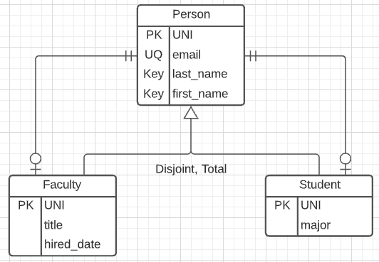
Person, Faculty, Student
Model
Complete:
Every entity is a Faculty or a Student.
There are no entities that are just Person.
Disjoint:
Either a Faculty or a Student
But not both.
3-Table solution.
Relationships:
Faculty-Person is one-to-one.
Student-Person is one-on-one.
Person is exactly 1.
Faculty or Student is 0-1.
There is no easy way to handle the fact that one of Faculty or Student must exist.

Slide 74
The UNI
The UNI creates some interesting challenges:
A given UNI is in two tables: Person, Faculty or Person, Student.
A given UNI can only be in the Faculty table or the Student table.
My algorithm for generating the UNI is:
Prefix: Concatenate
First two characters of first name.
First two characters of the last name
Suffix: Add 1 to the number of existing UNIs with the same prefix.
Concatenate the prefix and suffix.
Immutable: Cannot change.
Implementing the semantics in applications accessing the data is error prone.
The more places you implement something, the more places you can mess up.
You have to find all the apps and change them if the logic changes.
So, we are going to implement using a function and trigger.

Slide 75
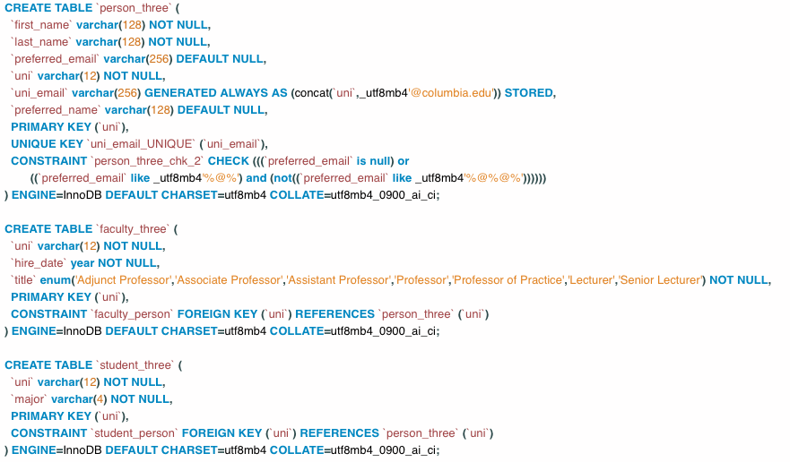
Table Definitions

Slide 76
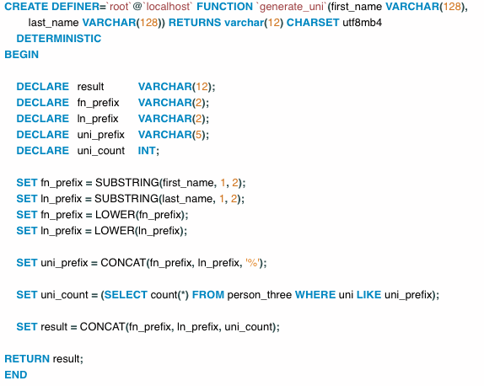
Function
Switch to notebook.

Slide 77
Projects: HW3 and HW4
77 | COMS W4111_002_2021_1: Lecture 5: Advanced SQL and Projects © Donald F. Ferguson, 2021

Slide 78
Pretend to Play Fantasy Baseball
My example projects for the two tracks will be a simple fantasy baseball solution.
“Fantasy baseball is a game in which people manage rosters of league baseball players, either online or in a physical location, using fictional fantasy baseball team names. The participants compete against one another using those players' real life statistics to score points.”
My solution will have two subsystems:
Analysis system:
Read only data that enables people to select players based on performance, and to estimate the performance of their fantasy team.
Event based update system that changes analysis data based on new data.
Operational system that manages create, retrieve update, delete, etc. of their fantasy teams and leagues.
INSERT, UPDATE, DELETE primarily apply to the operational system.

Slide 79
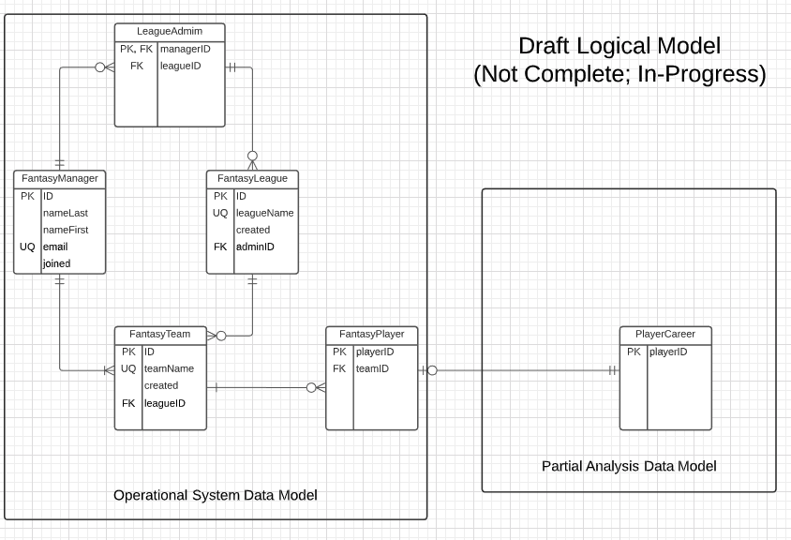
In-Progress Operation System Data Model

Slide 80
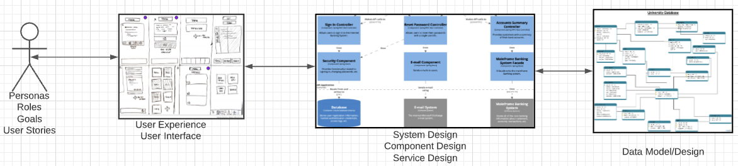
Problem Statement – Modified Reminder
We must build a system that supports academic operations in a university.
We will design, develop, test and deploy the system iteratively and continuously.
There are four core domains.
The processes are iterative, with continuous extension and details.
We will start implementing various user stories. Implementation requires:
Web UI
Paths
Data model and operations. (Will only cover this now).
In this course,
We focus on the data dimension.
We will get some insight into the other dimensions.

Slide 81
Web Application
IMDB Database
It would be “cool” if we
could look at the data directly!

Slide 82
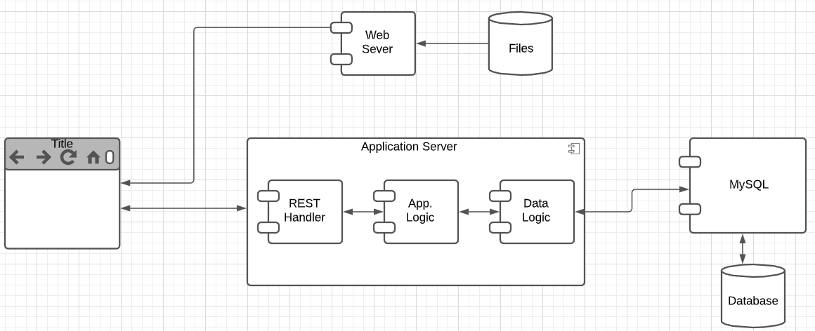
User Story
“In software development and product management, a user story is an informal, natural language description of one or more features of a software system. User stories are often written from the perspective of an end user or user of a system. ” (https://en.wikipedia.org/wiki/User_story)
Example user stories that I need to implement for the operational system:
”As a fantasy team manager, I want to search for players based on career stats.”
“As a fantasy team manager, I want to add a player to my fantasy team.
etc.
I need to implement:
UI
Application logic
Database tables.

Slide 83
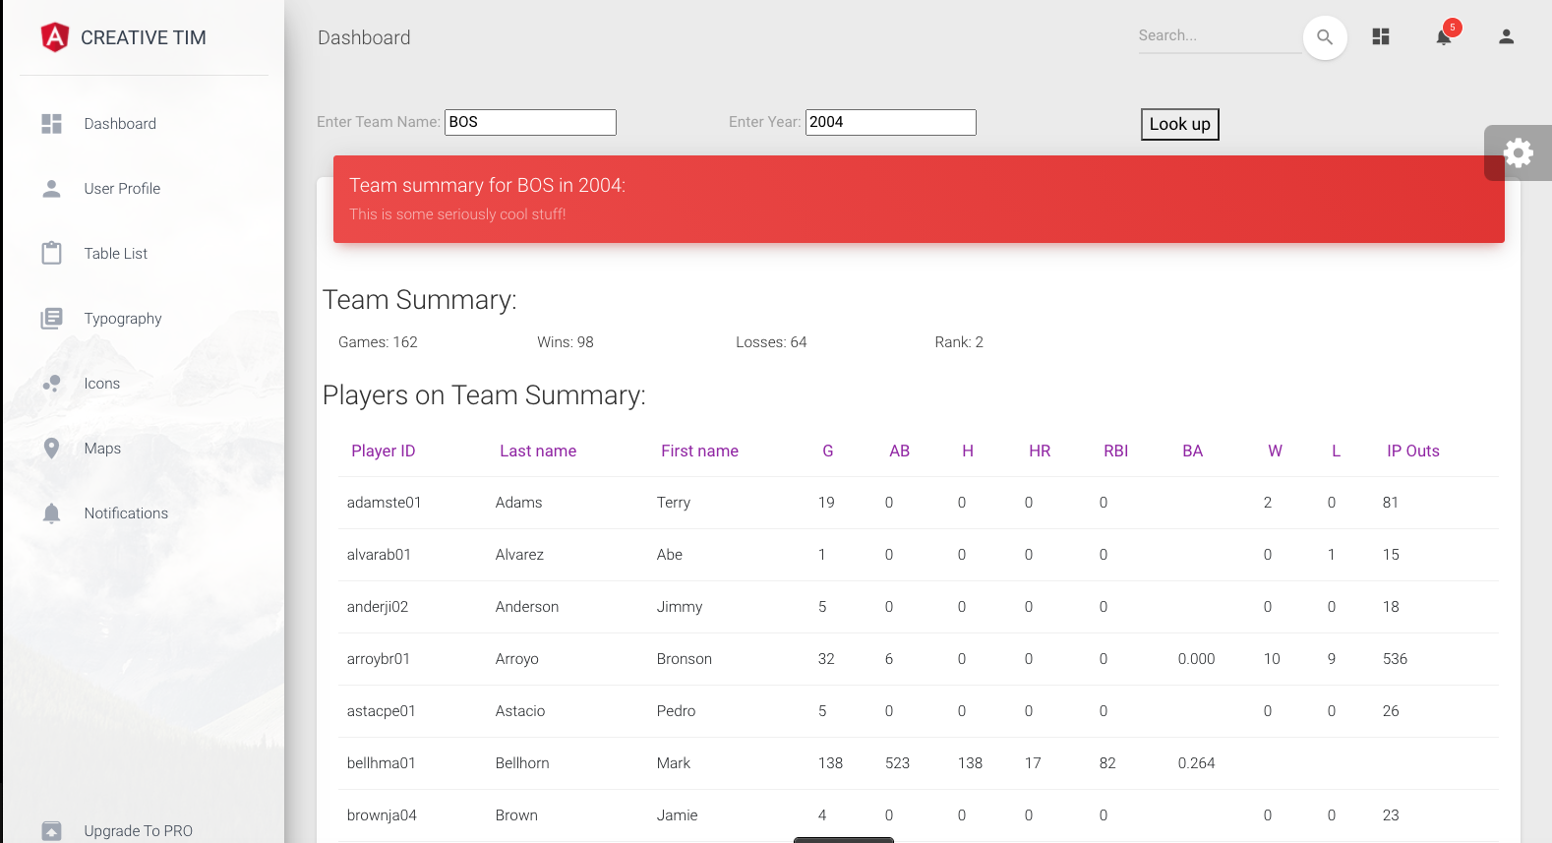
Simple Example
Web Application
MySQL
Two HTTP/REST calls:
GET /api/team_summary?team_id=BOS&year_id=2004
GET /api/teams?teamID=BOS&yearID=2004
Two SQL Queriess:
SELECT to Teams table.
SELECT to team_summary, which is a view. We cover views later.
“As a baseball fan, I want to enter a teamID and yearID and see:
Team wins and losses.
Summary of player performance for players on the team and year.”
Built:
Dashboard page.
REST handlers and application logic.
Database view.
Tracks will build:
Programming: Mix of CRUD and dashboard.
Non-programming: Dashboards, Data transformation.
Will see more details as we move forward.

Slide 84
Switch to Notebook
Switch to Notebook and Code.
Angular project
OpenAPI
Application code

Slide 85
Material to Read
85 | COMS W4111_002_2021_1: Lecture 5: Advanced SQL and Projects © Donald F. Ferguson, 2021

Slide 86
Some More Set-Like Concepts
86 | COMS W4111_002_2021_1: Lecture 5: Advanced SQL and Projects © Donald F. Ferguson, 2021

Slide 87
Set Comparison – “some” Clause
Find names of instructors with salary greater than that of some (at least one) instructor in the Biology department.
Same query using > some clause
select distinct T.name
from instructor as T, instructor as S
where T.salary > S.salary and S.dept name = 'Biology';
select name
from instructor
where salary > some (select salary
from instructor
where dept name = 'Biology');

Slide 88
Definition of “some” Clause
F <comp> some r ⇔ ∃ t ∈ r such that (F <comp> t ) Where <comp> can be: <, ≤, >, =, ≠
0
(5 < some
5
) = true
(read: 5 < some tuple in the relation)
6
0
(5 < some
5
) = false
0
(5 = some
) = true
5
0
(5 ≠ some
5
) = true (since 0 ≠ 5)
(= some) ≡ in
However, (≠ some) ≡ not in

Slide 89
Set Comparison – “all” Clause
Find the names of all instructors whose salary is greater than the salary of all instructors in the Biology department.
select name
from instructor
where salary > all (select salary
from instructor
where dept name = 'Biology');

Slide 90
Definition of “all” Clause
F <comp> all r ⇔ ∀ t ∈ r (F <comp> t)
0
(5 < all
5
) = false
6
6
(5 < all
) = true
10
4
(5 = all
) = false
5
4
(5 ≠ all
) = true (since 5 ≠ 4 and 5 ≠ 6)
6
(≠ all) ≡ not in
However, (= all) ≡ in

Slide 91
Test for Empty Relations
The exists construct returns the value true if the argument subquery is nonempty.
exists r ⇔ r ≠ Ø
not exists r ⇔ r = Ø

Slide 92
Use of “exists” Clause
Yet another way of specifying the query “Find all courses taught in both the Fall 2017 semester and in the Spring 2018 semester”
select course_id from section as S where semester = 'Fall' and year = 2017 and exists (select * from section as T where semester = 'Spring' and year= 2018 and S.course_id = T.course_id);
Correlation name – variable S in the outer query
Correlated subquery – the inner query

Slide 93
Use of “not exists” Clause
Find all students who have taken all courses offered in the Biology department.
Note that X – Y = Ø ⇔ X ⊆ Y
Note: Cannot write this query using = all and its variants
select distinct S.ID, S.name
from student as S
where not exists ( (select course_id
from course
where dept_name = 'Biology')
except
(select T.course_id
from takes as T
where S.ID = T.ID));
First nested query lists all courses offered in Biology
Second nested query lists all courses a particular student took

Slide 94
Test for Absence of Duplicate Tuples
The unique construct tests whether a subquery has any duplicate tuples in its result.
The unique construct evaluates to “true” if a given subquery contains no duplicates .
Find all courses that were offered at most once in 2017
select T.course_id from course as T where unique ( select R.course_id from section as R where T.course_id= R.course_id and R.year = 2017);

Slide 95
Completing Subqueries
A subquery is a query inside a query.
Logically, the engine calls the subquery when evaluating every row in processing.
Correlation means properties from the outer row being evaluated are inputs to the inner query.
Subqueries:
Return tables if in the FROM clause.
Scalars in the SELECT clause.
Tables or scalars depending on the comparison operator in WHERE.
95 | COMS W4111_002_2021_1: Lecture 5: Advanced SQL and Projects © Donald F. Ferguson, 2021

Slide 96
Subqueries in the From Clause
SQL allows a subquery expression to be used in the from clause
Find the average instructors’ salaries of those departments where the average salary is greater than $42,000.”
select dept_name, avg_salary from ( select dept_name, avg (salary) as avg_salary from instructor group by dept_name) where avg_salary > 42000;
Note that we do not need to use the having clause
Another way to write above query
select dept_name, avg_salary from ( select dept_name, avg (salary) from instructor group by dept_name)
as dept_avg (dept_name, avg_salary)
where avg_salary > 42000;

Slide 97
Scalar Subquery
Scalar subquery is one which is used where a single value is expected
List all departments along with the number of instructors in each department
select dept_name, ( select count(*) from instructor where department.dept_name = instructor.dept_name) as num_instructors from department;
Runtime error if subquery returns more than one result tuple

Slide 98
Switch to Notebook
Switch to Notebook

Slide 99
Backup
Backup

